Slide 1
Managing Mixed Modeled Data using Polystore.
Subhasis Dasgupta, Ph.D

Slide 2
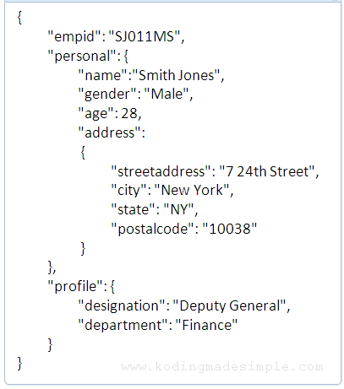
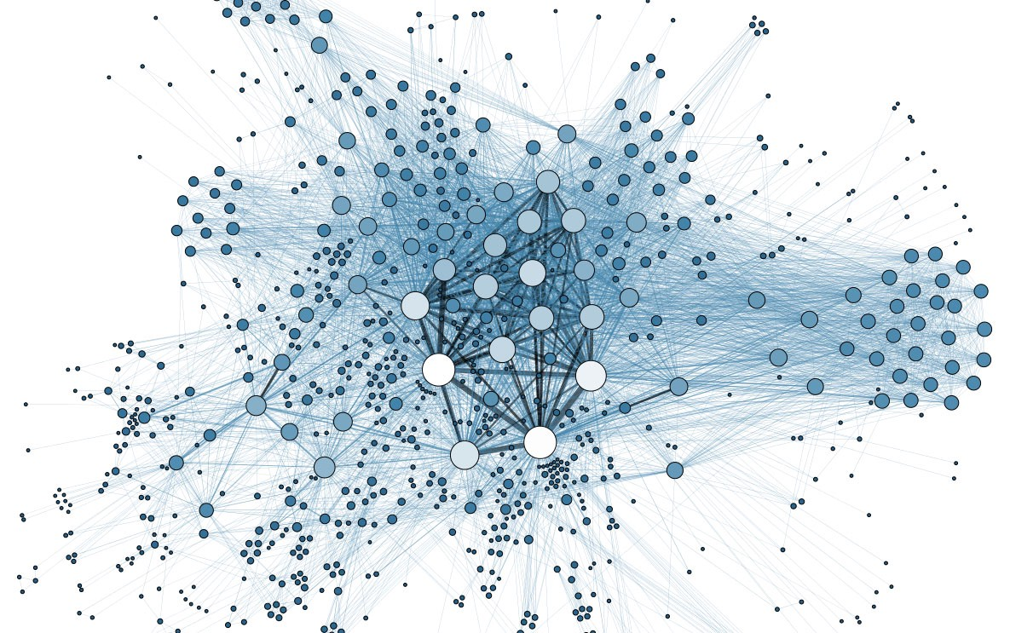
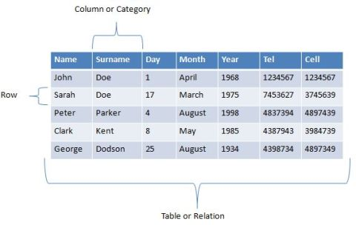
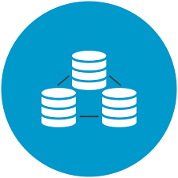
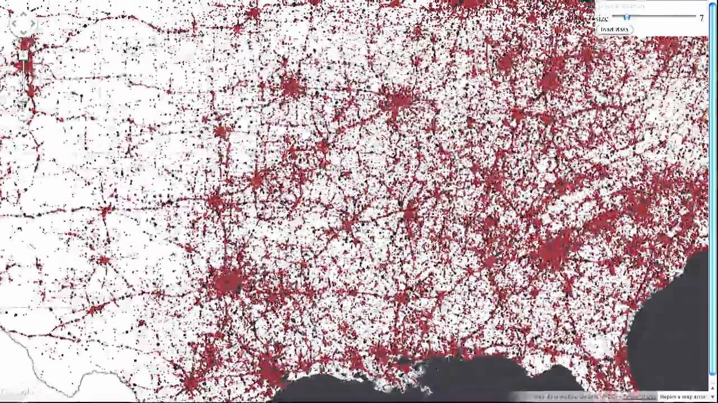
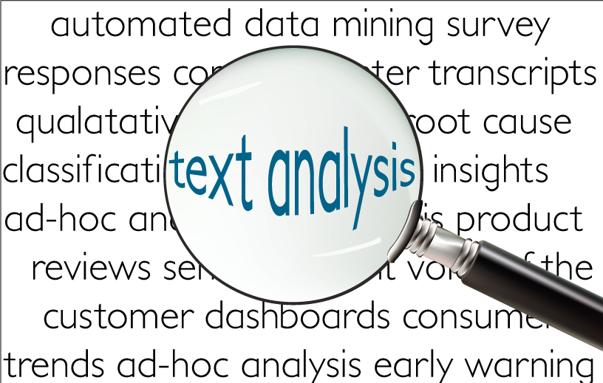
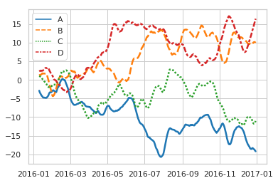
Mixed Modeled Data
We produce, use, analyze, and store a massive amount of data for various purposes.
We modeled them differently to enable analysis.
Hence we need to handle different model of data in reality.
Notes:
If we do not want to retrieve we don’t need to model the
File is not very good option to store the data, we need databases, proper indexing, view management etc.

Slide 3
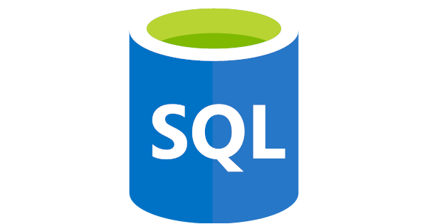


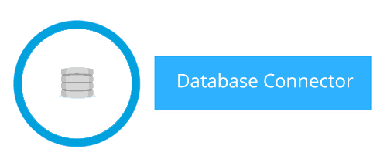

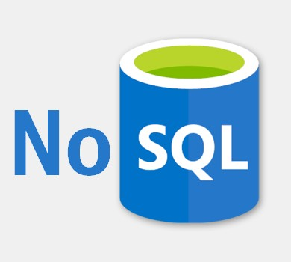
How do we access Data from a database?
Notes:
If we do not want to retrieve we don’t need to model the
File is not very good option to store the data, we need databases, proper indexing, view management etc.

Slide 4
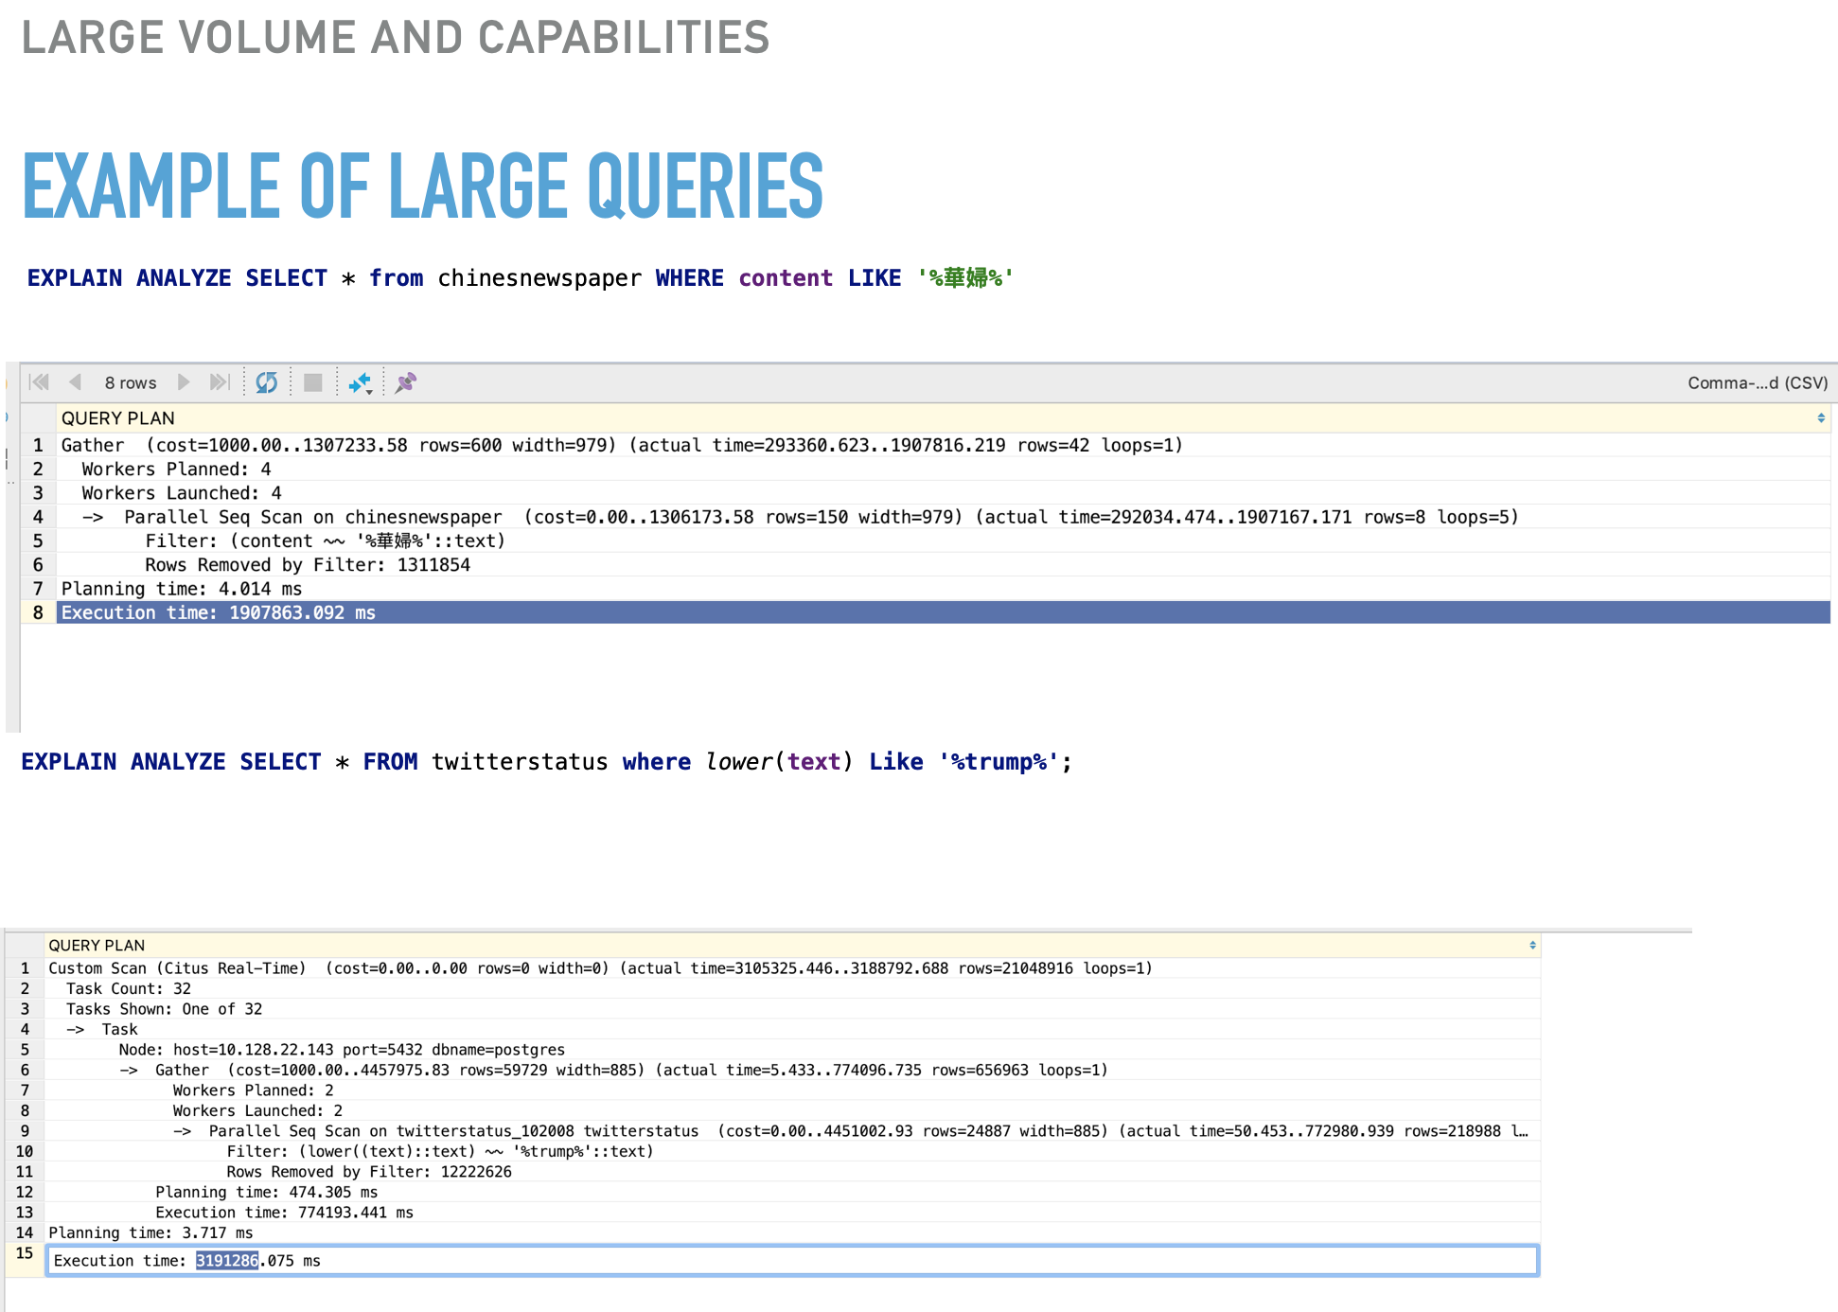

Slide 5
“No One Size Fits All”

Slide 6
Where do I find a database of databases?

Slide 7
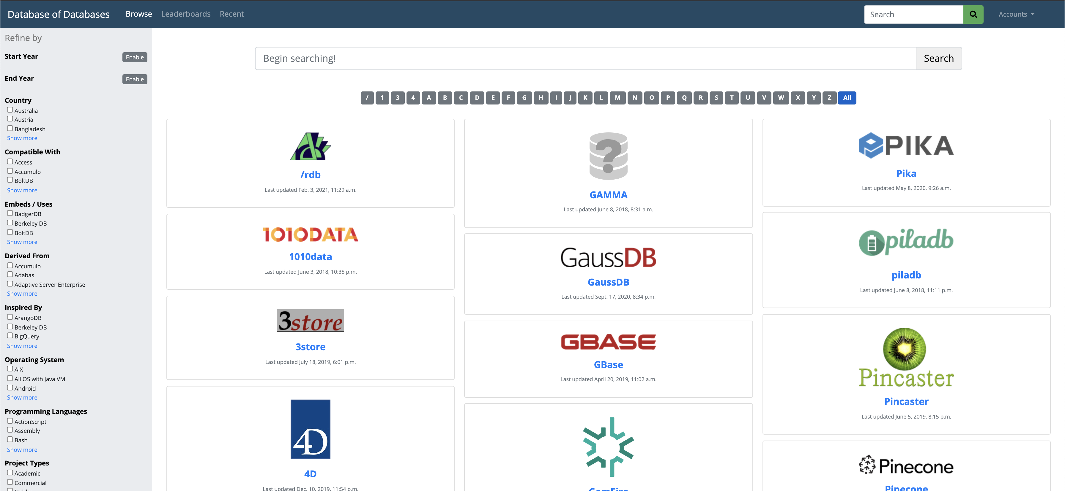
www.dbdb.io

Slide 8
Model Specific Databases

Slide 9
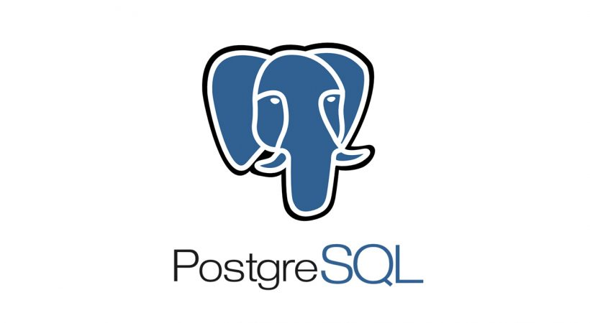

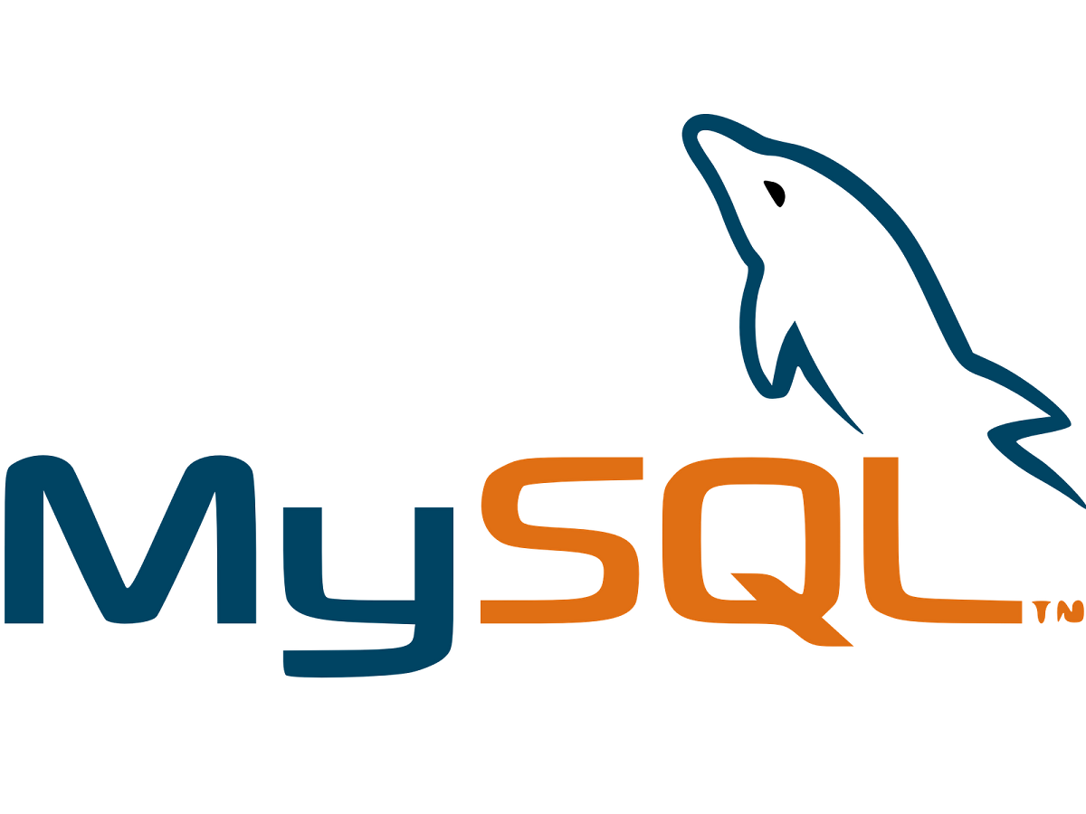









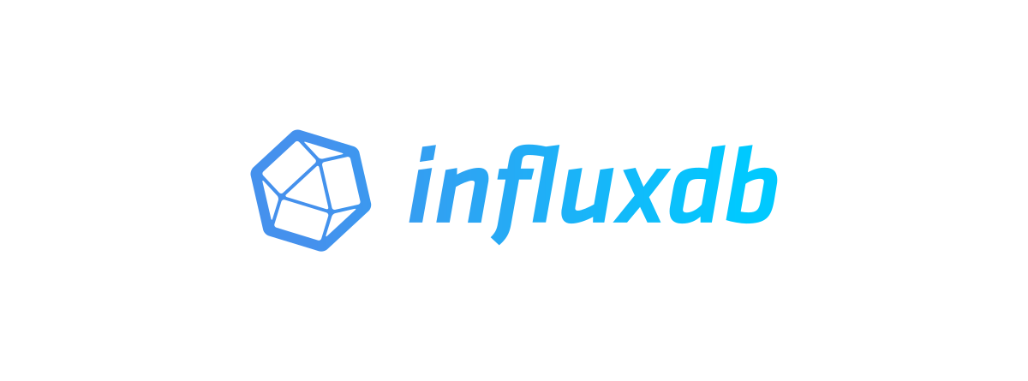


A Few Model Specific Databases
Relational DB
Graph DB
Search DB
Semi-structured DB
Timeserise DB
Spatial DB

Slide 10








Model Specific Databases
Key Value Storage
Data Processing Platform and dataframe technology
And Many...

Slide 11
Why so many models and apps?
In recent times, the database community has built many apps and techniques to handle various models and capabilities.(Like relational, semi-structured, or networks models and the capabilities like inverted index, data cube (Group by, CUBE by), centrality computation )
These developments focused on a targeted vertical or solved domain-specific problems.
Each of the apps developed and tuned best for its model and capabilities but incapable of the others.
Relational Structure
SQL
Cube and Group queries
Text search (Gin, GIST)
Network queries
Centrality computation
Relational Structure
Cypher
Cube and Group queries
Text search (Gin, GIST)
Network queries
Network analytics
Text search
Network queries
Network analytics(Centrality, cluster, pagerank )

Slide 12
Design Goals of a Polystore Systems
Polystore should support location transparency like federated databases (i.e., common query language).
Semantic Completeness: The user will not lose any capabilities provided by its underlying storage engine.
Object Version Consistency: The same version of the object should be available in multiple models.
Capability based Optimization : Optimize the analytical computation depending on the capabilities.

Slide 13
Architectural Variations
Loosely Coupled
Cross model mediator based design, each provider will have a dedicated mediator to communicate with other providers.
Local storage has more control over the data, and the global controller maintains consistency and transparency.
Local operations are efficient, but model transformation cost is high.
Challenging to optimize analytical operations and create cross model materialized view and cross model index.
Tightly Coupled
Use a common interface to interact among stores, like a standard data frame or data structure for the whole polystore.
Local storage has less control over the data, and the central controller decides everything.
Transforming or rewriting queries from one store to another store is complex and ultimately boils down to a multi-query optimization problem.
It is hard to optimize the best plan for each store. The optimization cost is very high.
Easy to build a materialized view and index.
Hybrid
Trade-off between global control and local control
Very efficient for optimizing queries for each local storage.
Easy and efficient use of materialized view is possible.
Very much domain or vertical specific.

Slide 14
Example Polystore Systems
BigDAWG, MIT
CloudMdsQL, Inria
Estocada, UCSD and Inria
Polypheny-DB, University of Basel, Switzerland
Awesome, UCSD(*)
Polystore++ , Stanford University
Polybase, Microsoft.
OoX, HP-Labs

Slide 15
The Awesome Polystore

Slide 16
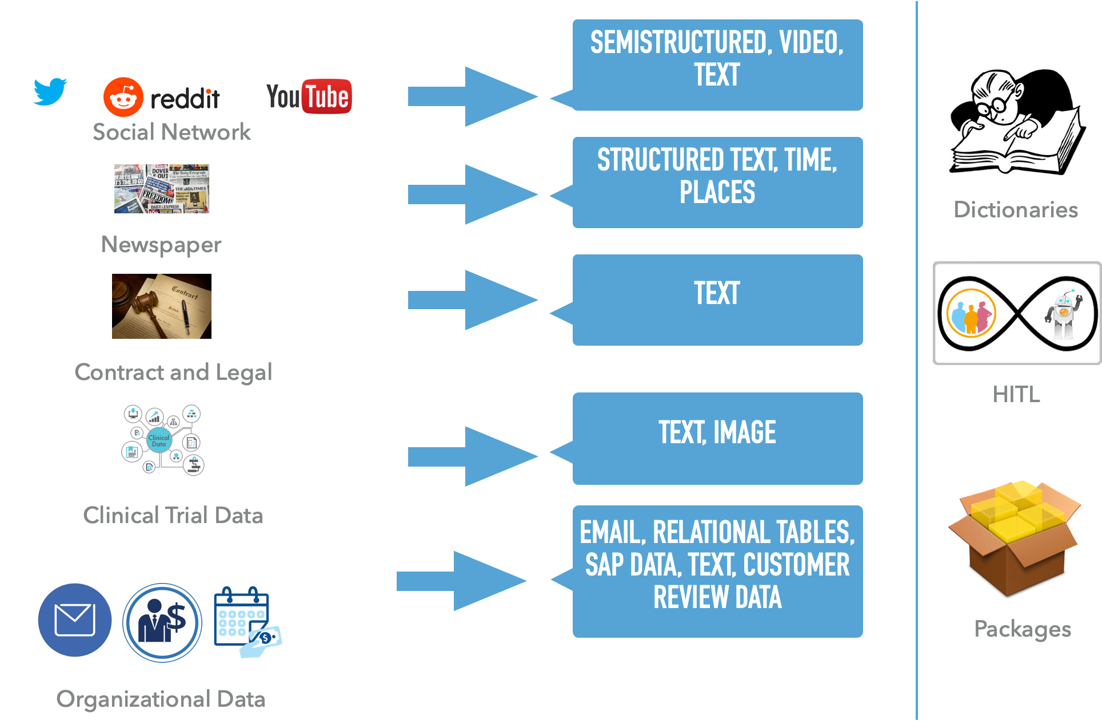
Data Variety

Slide 17
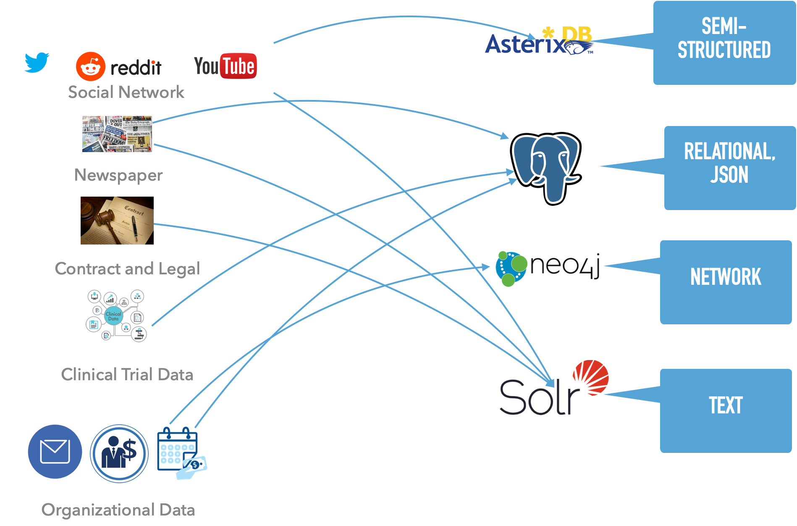

Slide 18
Social Sciences Questionnaire:
List all the accounts mentioned “Elizabeth Warren ” and also talking about “American DOS Movements.”
Find top 100 influential users those are co-spiking and talking about racial terms from the “Elizabeth Warren’s” network.
Find out top-k topics from the newspaper, those are also discussed in the “Elizabeth Warren’s” network.
Top k-topics discussed in the network but not covered by the newspaper.

Slide 19
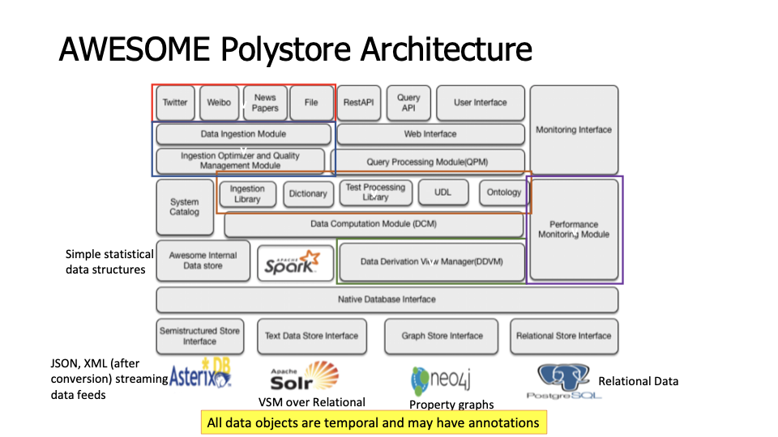
Summary of Awesome Architecture
AWESOME integrates information over heterogeneous data
A relational DBMS
A graph DBMS
A document/semi-structured DBMS
A text search engine
Vector and Matrix data from Analytics engines

Slide 20
The Knowledge Graph Case Study

Slide 21
Building a Knowledge Graph on the top of a polystore
The Problem
“Discover technology gaps in some domain and who can bridge the gaps?”
Data Set : all publicly available data
Solution Approach
Create a Knowledge graph by assimilating information from multiple data sources.
Search term expansion and association mining using KG
Gap discovery using network query
Potential partnership determination using Cube query

Slide 22
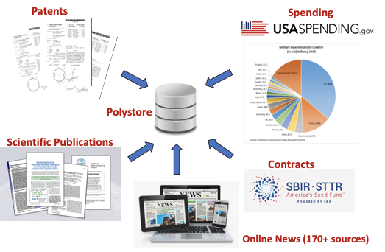
Building a Knowledge Graph Contd..

Slide 23
Query on Knowledge Graph
Search
Expand the search term automatically using the ontology.
Return a data cube with various distributions.
Gap Analysis
Find the technological associations by looking at network structure
Find the differences or gap of those structural associations.
Opportunity Analysis
Find collaboration opportunities from the network associations and other data.

Slide 24
Demo

Slide 25
Duggan J, Elmore AJ, Stonebraker M, Balazinska M, Howe B, Kepner J, Madden S, Maier D, Mattson T, Zdonik S. The bigdawg polystore system. ACM Sigmod Record. 2015 Aug 12;44(2):11-6.
Dasgupta, Subhasis, Kevin Coakley, and Amarnath Gupta. "Analytics-driven data ingestion and derivation in the AWESOME polystore." 2016 IEEE International Conference on Big Data (Big Data). IEEE, 2016.
Zheng, Xiuwen, et al. "Processing Analytical Queries in the AWESOME Polystore [Information Systems Architectures]." arXiv preprint arXiv:2112.00833 (2021).
Mattson, T., Gadepally, V., She, Z., Dziedzic, A., & Parkhurst, J. (2017, January). Demonstrating the BigDAWG Polystore System for Ocean Metagenomics Analysis. In CIDR.

Slide 26
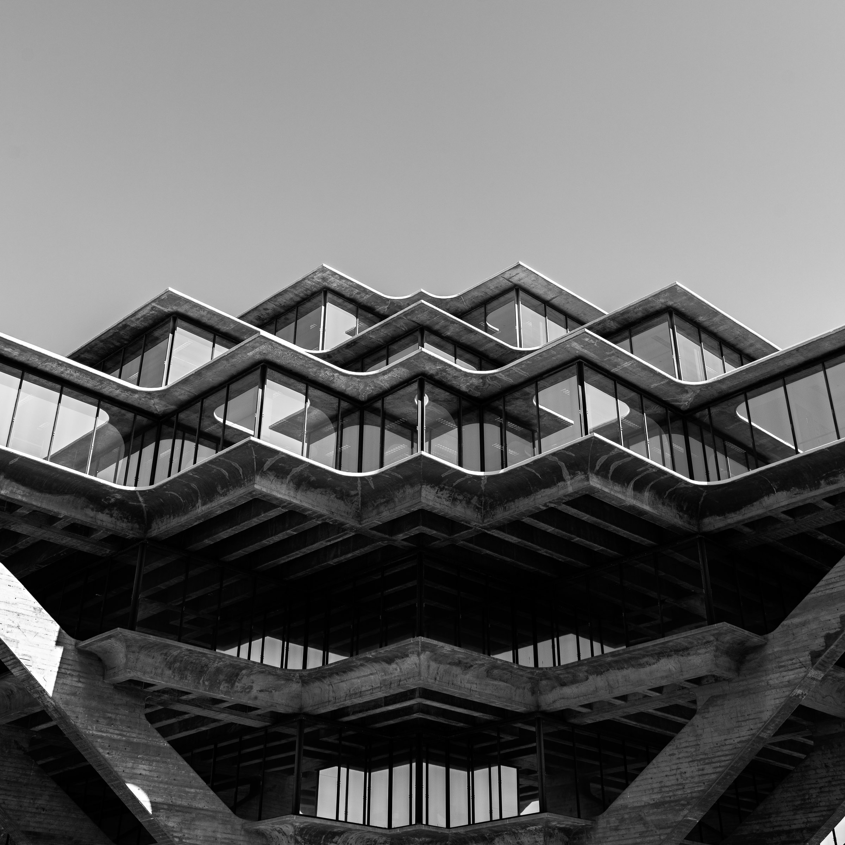
Thanks!
Contact me:
sudasgupta@ucsd.edu

